Slide 1
GLOVE MOUSE
Submitted By: Naveen Lalwani
14BEE0112
Vellore Institute of Technology, Vellore
Fall 2016

Slide 2
Objective
To develop the prototype of a wearable glove mouse which can work mid air without any support of hard base unlike a conventional mouse with Bluetooth connectivity.

Slide 3
Hardware Used
Arduino LEONARDO
Accelerometer (3 axial) ADXL335
Bluetooth HC-05 modules
Flex Sensors 2.2’’ inch (Quantity = 2)
USB Cable
Jumper Wires
Resistors and Capacitors Of varied Values
A Glove

Slide 4
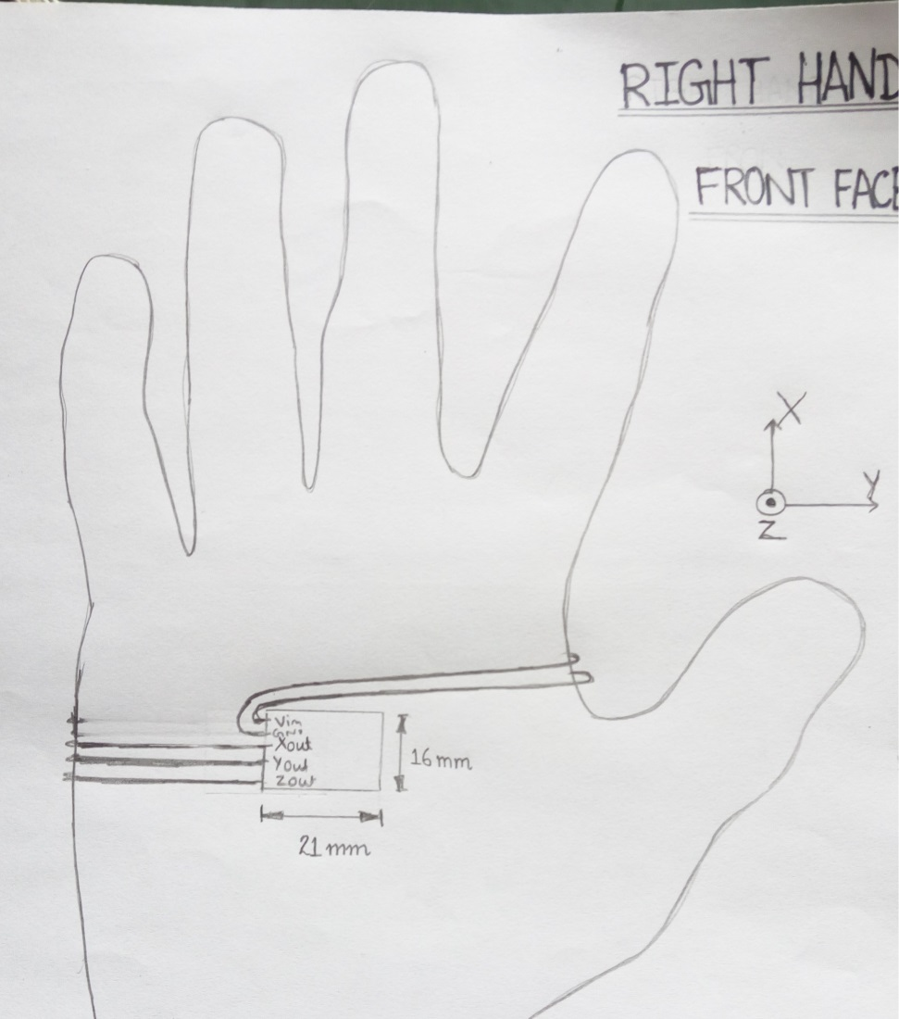
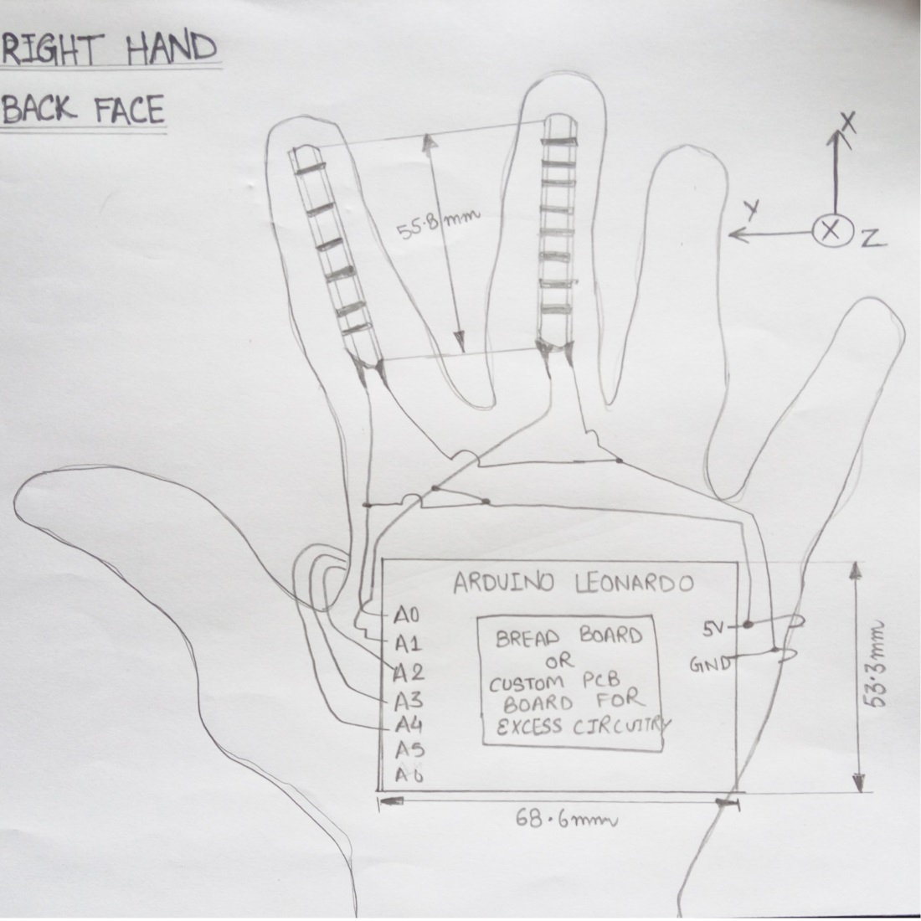
Rough Sketch

Slide 5
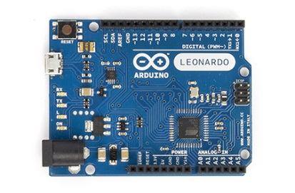
Arduino LEONARDO
The Arduino Leonardo is a microcontroller board based on the ATmega32u4
With USB HID capabilities

Slide 6
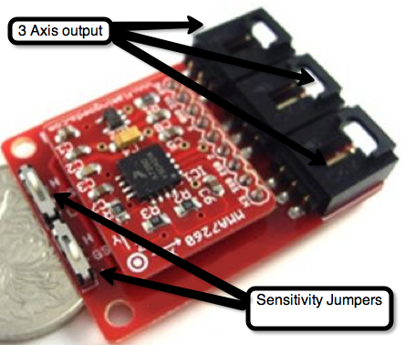
Accelerometer
Used to detect and map user hand motions to the mouse cursor movements to measure hand tilt and orientations.
The accelerometer reads the tilt of each axis (3 axis) and outputs each as an analog voltage.

Slide 7
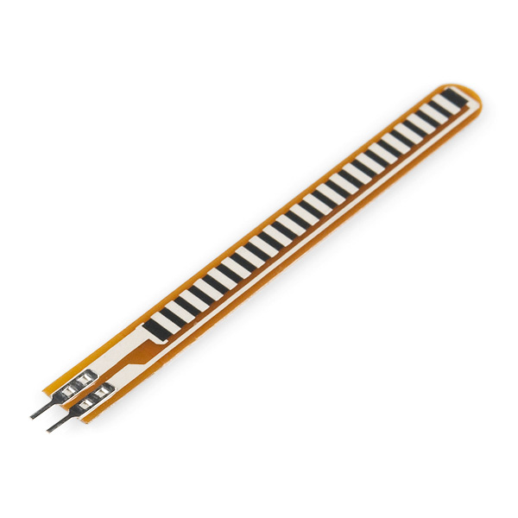
Flex Sensor
Used to detect pointing device button commands by sensing if there is flexing of the fingers
Two flex sensors for two button commands left and right click

Slide 8
Software Used
Arduino Software IDE (contains a text editor for writing code, a message area, a text console, a toolbar with buttons for common functions and a series of menus. It connects to the Arduino hardware to upload programs and communicate with them.)

Slide 9
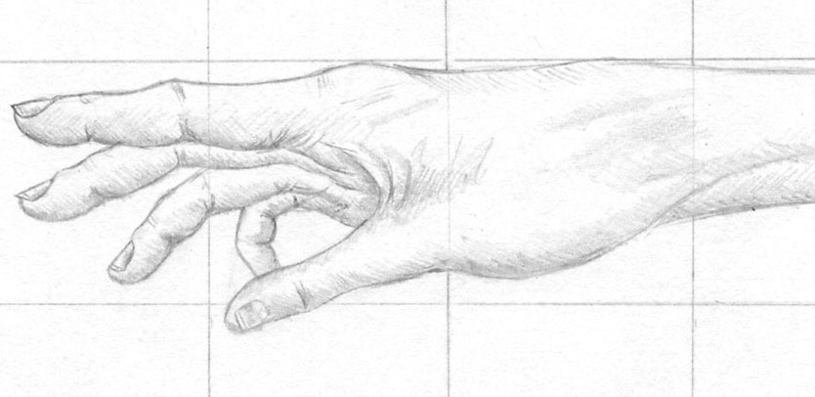
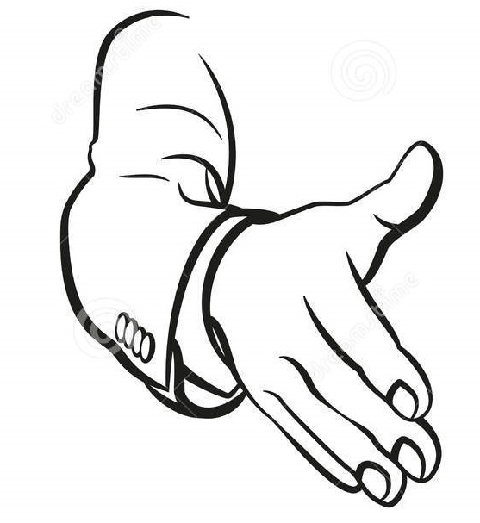
Modes Of Working
NORMAL MODE
Conventional style i.e. no change in z direction
Suitable for working
HANDSHAKE MODE
Vertical Mode i.e. no change in y direction
Suitable for gaming (especially point and shoot games)

Slide 10
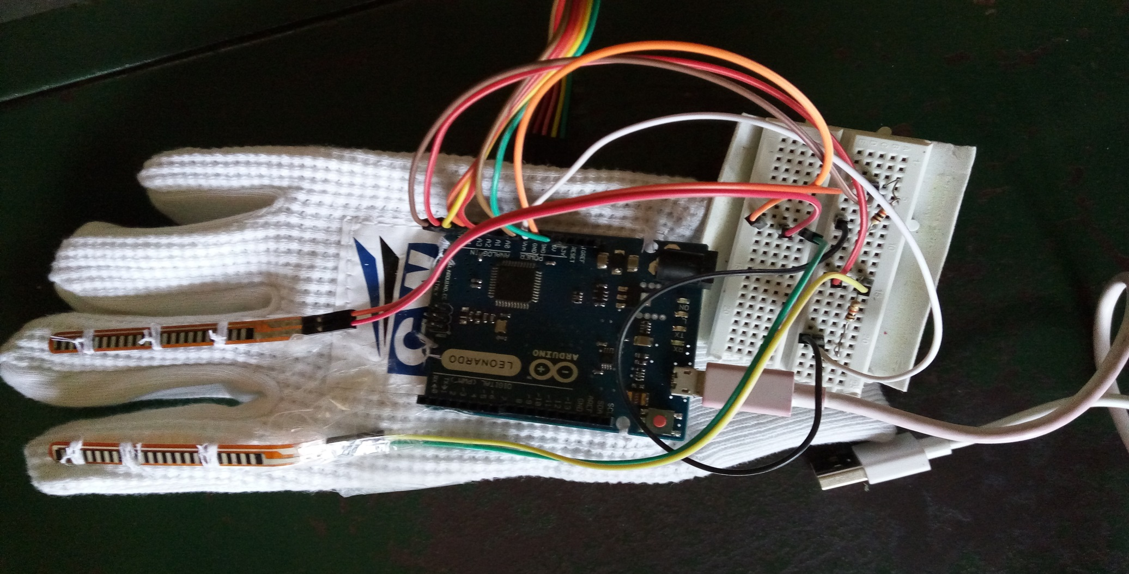
Prototype Circuit

Slide 11
Applications
Can help prevent Carpal Tunnel Syndrome (numbness, tingling, weakness in your hand because of pressure on the median nerve in your wrist)
Can be used for Point and shoot games exclusively like Virtual Cop 2
Allowing mouse to work in mid air gives it a good edge in presentations
The circuitry can be fixed on Goggles (Mouse Goggles) or headphones and can be used amputees to control mouse pointer by tilting their head in x and y direction

Slide 12
Thank You

